Slide 1

Stock Price Prediction
using Machine Learning
Submitted By : - M.C.A. (Regular Entry) Semester-VI
Preyash S. KaPatel
(18034211003)
Guided by
Dr. Jigneshkumar A. Chauhan (Internal Guide)
xxxxxx… (External Guide)
Submitted to Acharya Motibhai Patel Institute of Computer Studies,
GANPAT UNIVERSITY
Dec-April 2021

Slide 2
Project Profile

Slide 3
Project Profile
Project Title | Stock Price Prediction using Machine Learning
Project category | Web Application
Objective | To Predict the stock price based on the past and upcoming events.
Front End | Django
Back End | Django, Python
Tool | Anaconda, Google Colab
Server | XAMP
Documentation Tool | Office 365
Company Name
Internal Guide | Dr. Jigneshkumar A. Chauhan
External Guide
Developed By | Preyash Sanjay KaPatel (1803421003)
Group No | 19

Slide 4
Requirement Specification

Slide 5
Existing system
The existing system works as follow :
Money related transaction require high alertness of statistical insights of history and future events, In such case taking decision of stake sale, hold or buy are difficult.
Before taking decision we need to look at the past data, stock patterns, Recent news and judging the price takes time and it might end up in slow decision, incomplete information etc.
Taking the Stake sale/buy/Hold based on emotion and incomplete information may perform false prediction.
Drawback of Existing System
Incomplete Information
Emotion based Decision
Unawareness of stock price patterns

Slide 6
Need for new system
Rapid Decision:
User can take decision rapidly as it is performed autonomous.
Improved Accuracy:
User can use the result to take decision for stake sale or hold or buy
Based on Historic data:
Prediction are based on historic data and past events.

Slide 7
USED HARDWARE AND SOFTWARE CLINET SIDE
Minimum Requirement of Hardware and Software:
Hardware Requirement:
Basic CPU with 700 MHz Speed
1 GB RAM
Software Requirement:
Chrome with 68.0.3440.75 or above Version
Good Internet Speed

Slide 8
USED HARDWARE AND SOFTWARE Server SIDE
Minimum Requirement of Hardware and Software:
Hardware Requirement:
Inter i3 10th generation
4 GB RAM
250 mb Space in SSD
Software Requirement:
Chrome with 68.0.3440.75 or above Version
High Speed Internet
Google Colab
Webpage IDE
Github Desktop

Slide 9
FUNCTIONAL MODULE SPECIFICATION

Slide 10
Functional Module Specification
Login:
Admin and Account Holder can access website by successfully login
Watchlist:
User can add remove stock from watchlist.
Holdings:
Here user can see there stock holding if they have.
Predictions:
In this module user can predict the stock price.

Slide 11
SYSTEM FLOW CHART

Slide 12
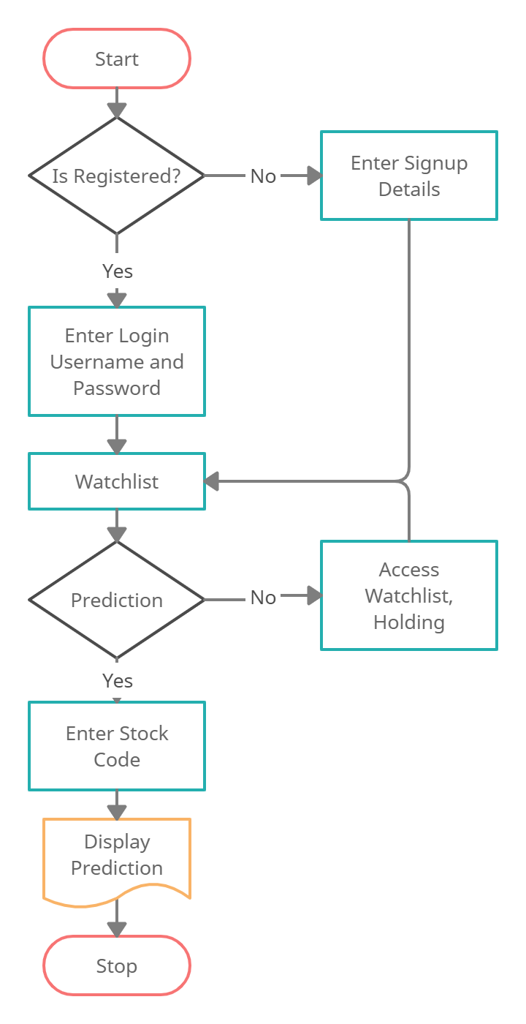
SYSTEM FLOW CHART for User

Slide 13
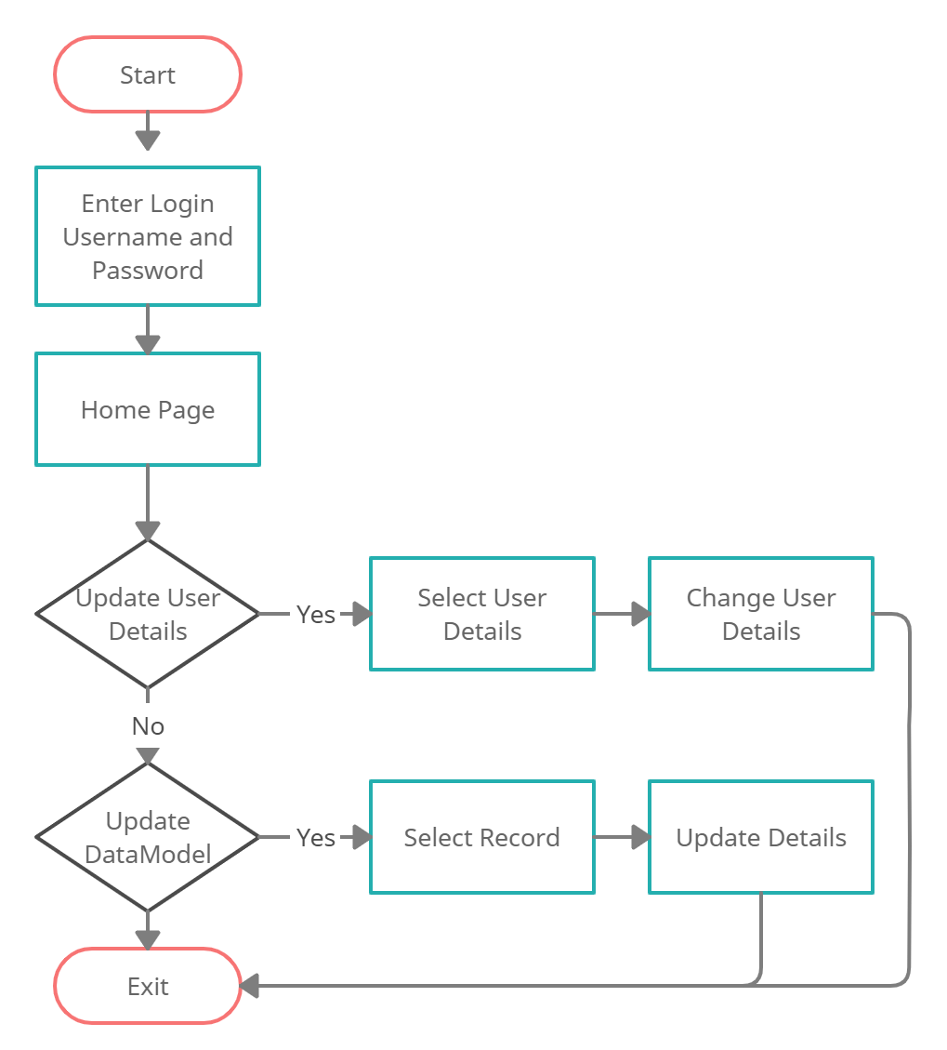
SYSTEM FLOW CHART for Admin

Slide 14
Use-Case Diagram

Slide 15
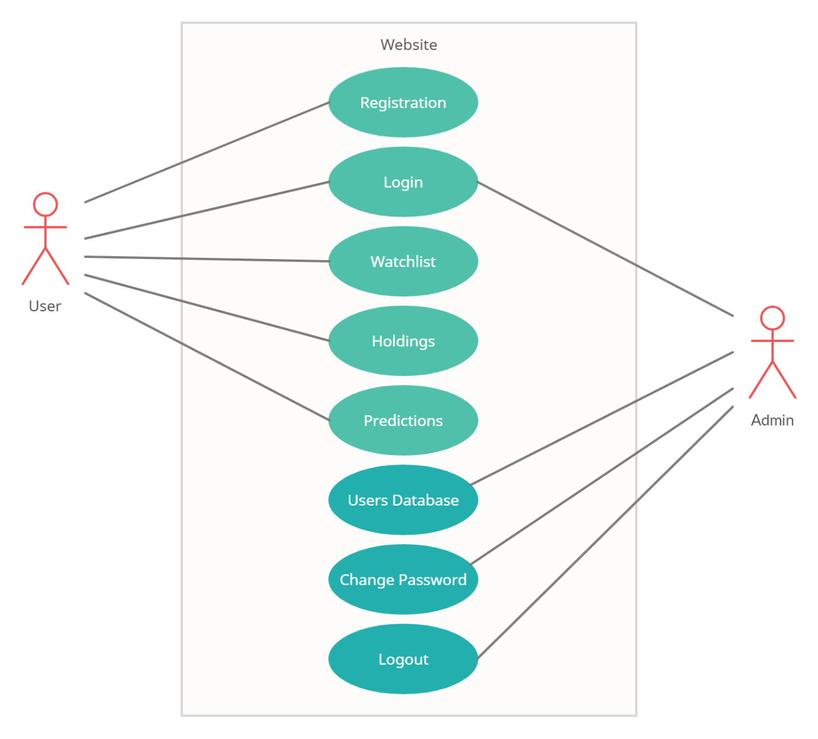
Use-Case Diagram

Slide 16
Class Diagram

Slide 17
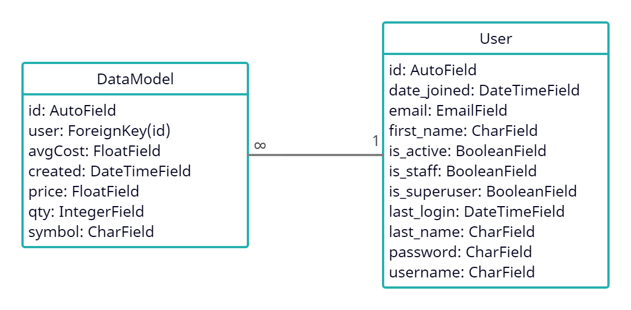
Class Diagram

Slide 18
Sequence Diagram

Slide 19
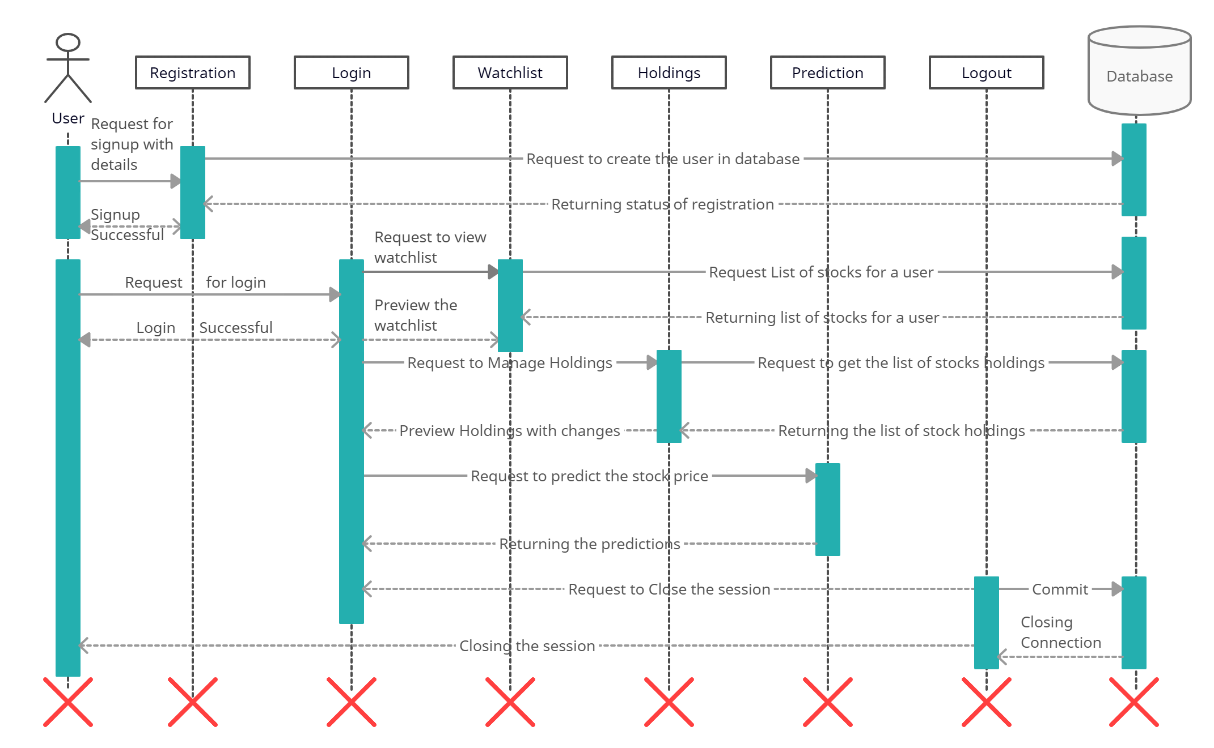
Sequence Diagram for User

Slide 20
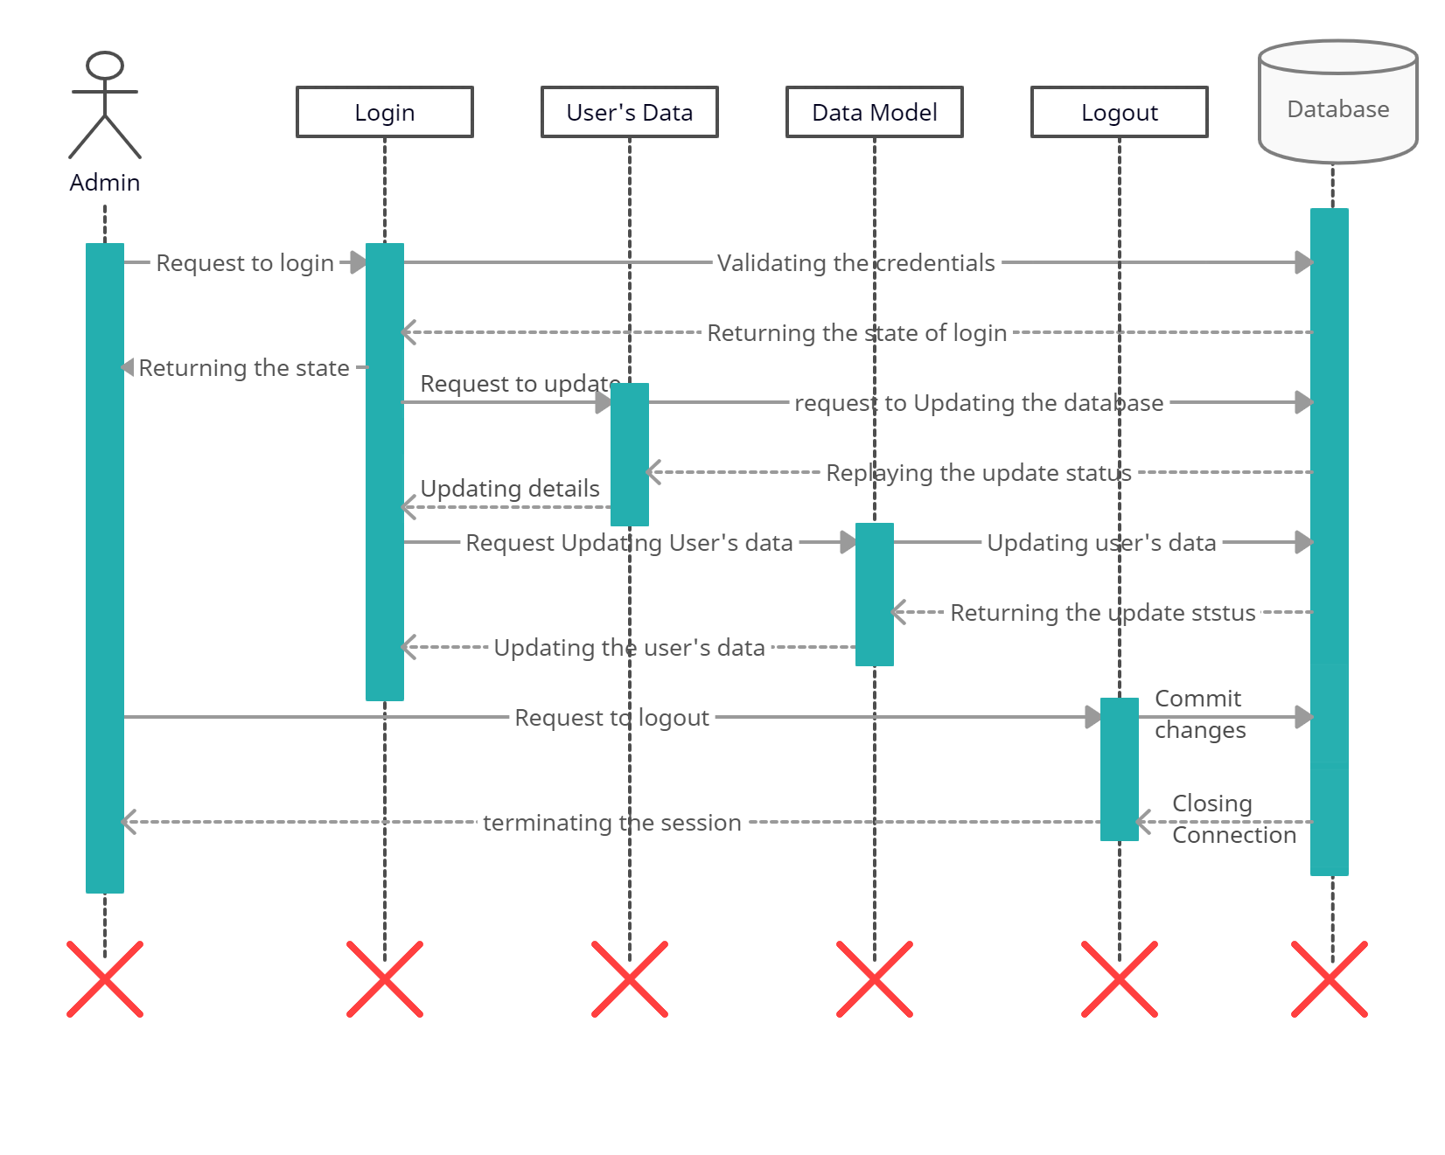
Sequence Diagram for Admin

Slide 21
Activity Diagram

Slide 22
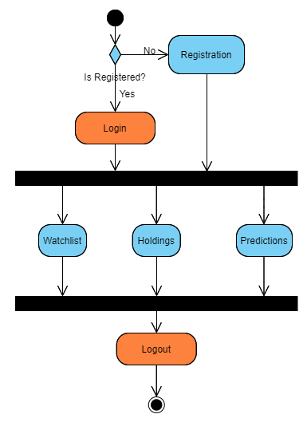
Activity Diagram for User

Slide 23
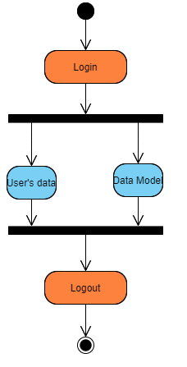
Activity Diagram for User

Slide 24
Deployment Diagram

Slide 25
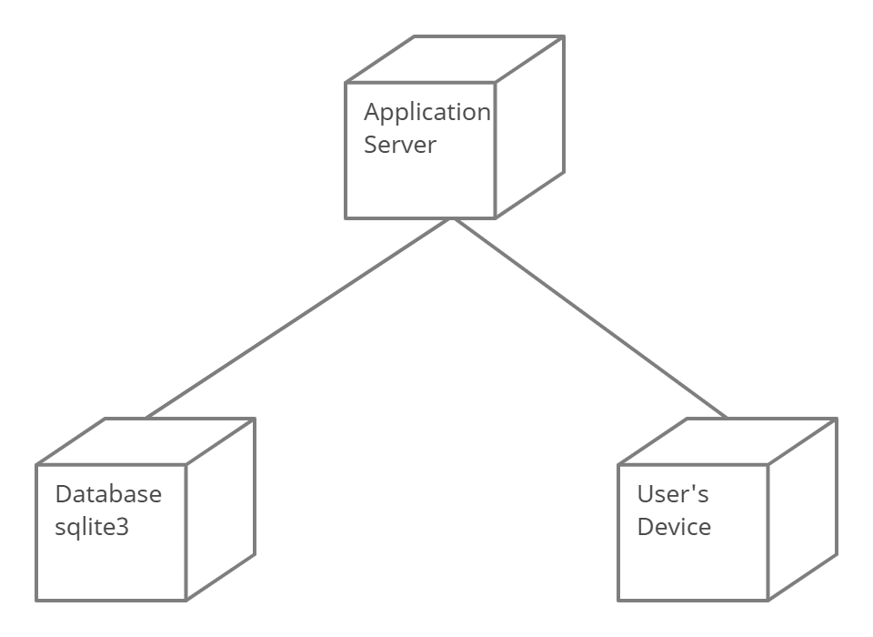
Deployment Diagram

Slide 26
Data Dictionary

Slide 27
Data Dictionary
Name: DataModel
DESCRIPTION :- Represents stock holding and watchlist Primary Key: id
Sr.No | Field Name | Data Type | Constraint | Description
1 | id | IntegerField | Primary Key | Represent Record id
2 | user | ForeignKey | ForeignKey | Represent registered User
3 | avgCost | FloatField | Not Null | Represent Average cose
4 | created | DateTimeField | Not Null | Represent stock addition date and time
5 | price | FloatField | Not Null | Represent last updated price
6 | qty | IntegerField | Not Null | Represent quenty
7 | symbol | CharField | Not Null | Represent stock symbol

Slide 28
Data Dictionary
Name: User
DESCRIPTION :- Represents users’s details Primary Key: id
Sr.No | Field Name | Data Type | Constraint | Description
1 | id | IntegerField | Primary Key | Represent user id
2 | Date_joined | DateTimeField | Not Null | Represent date of joining
3 | email | EmailField | Not Null | Represent Email id of user
4 | First_name | CharField | Not Null | Represent First Name
5 | Is_active | BooleanField | Not Null | Represent user status
6 | Is_staff | BooleanField | Not Null | Represent user is staff member or not
7 | Is_superuser | BooleanField | Not Null | Represent user is super user or not
8 | last_login | DateTimeField | Not Null | Represent last login date and time
9 | last_name | CharField | Not Null | Represent user’s last name
10 | Password | CharField | Not Null | Represent password
11 | username | CharField | Not Null | Represent username

Slide 29
Input & Output Design

Slide 30
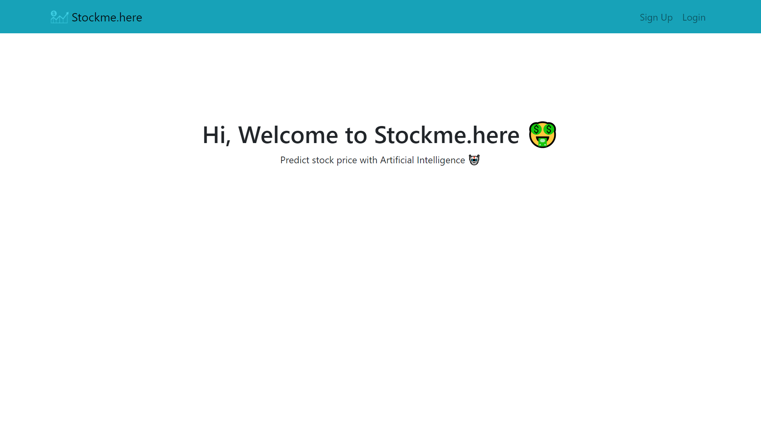
Home Page

Slide 31
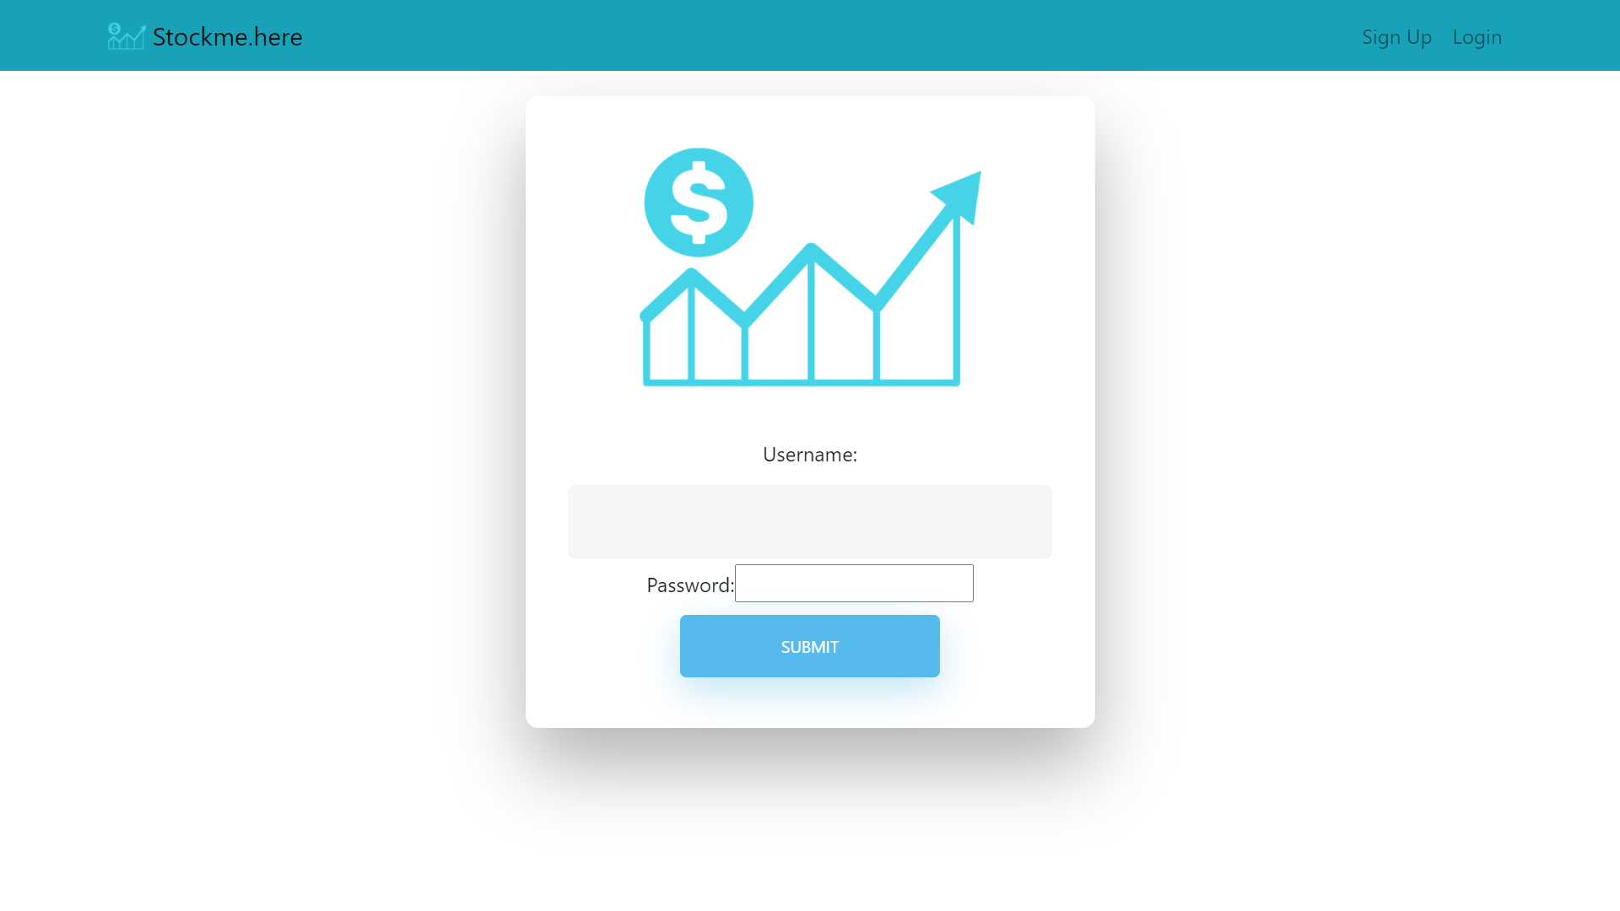
Login Page

Slide 32
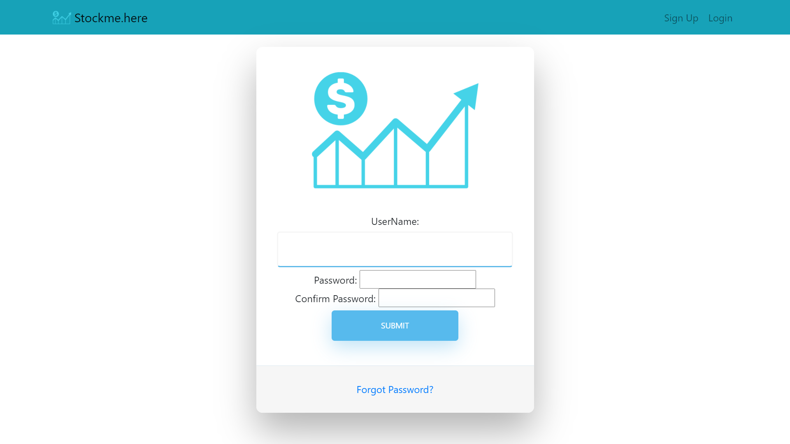
Signup Page

Slide 33
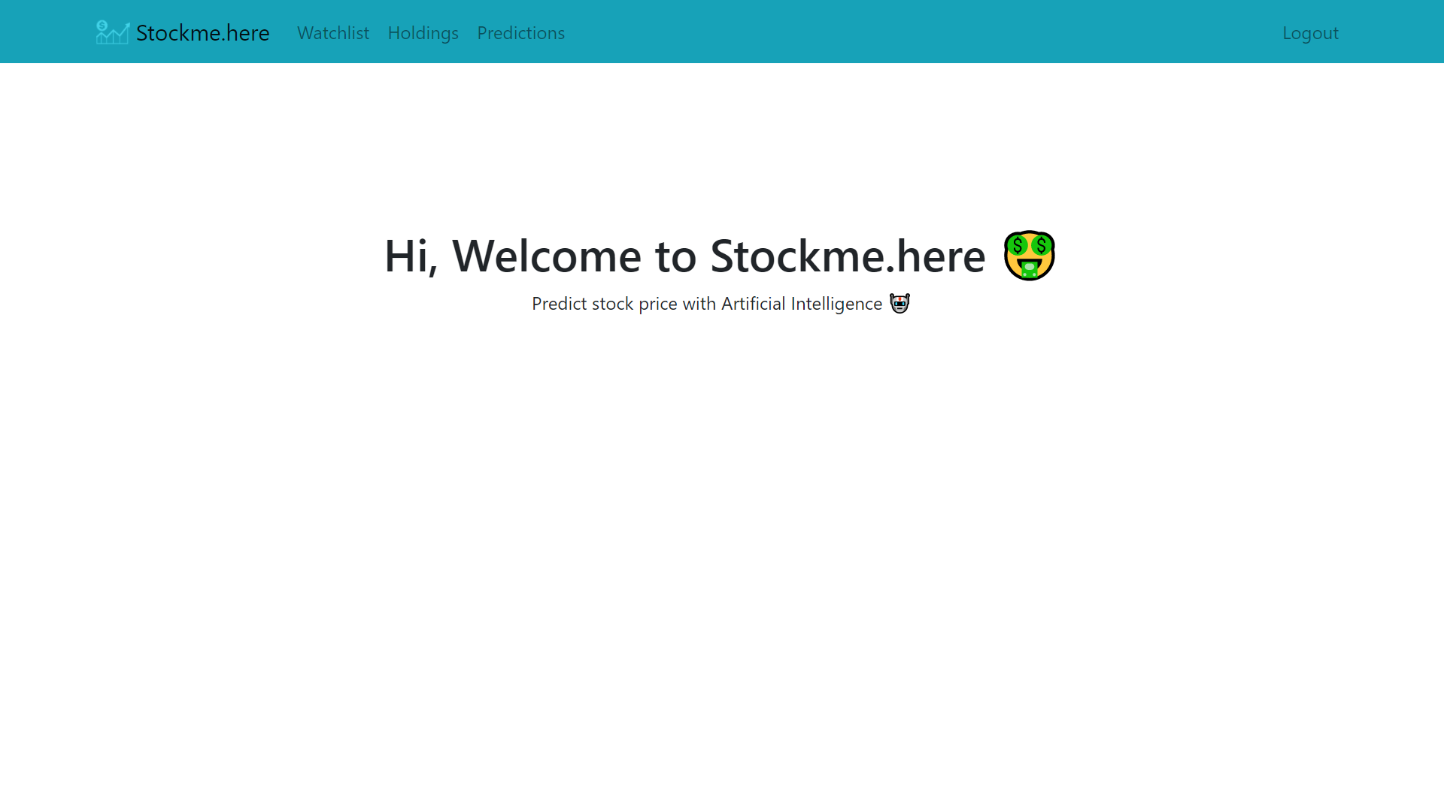
Home after login

Slide 34
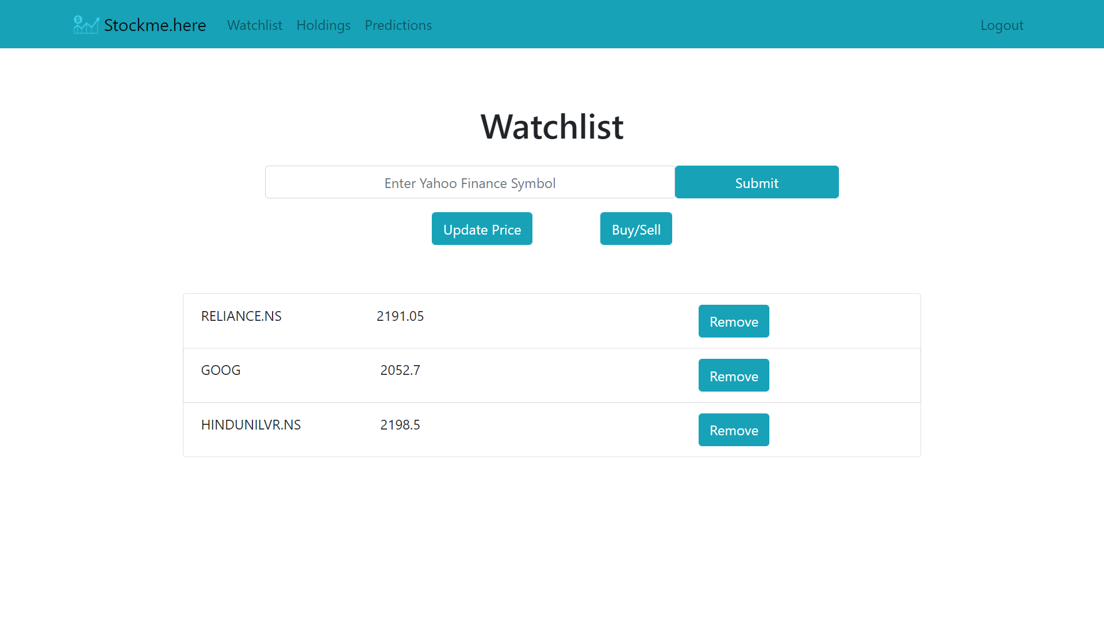
Watchlist Page

Slide 35
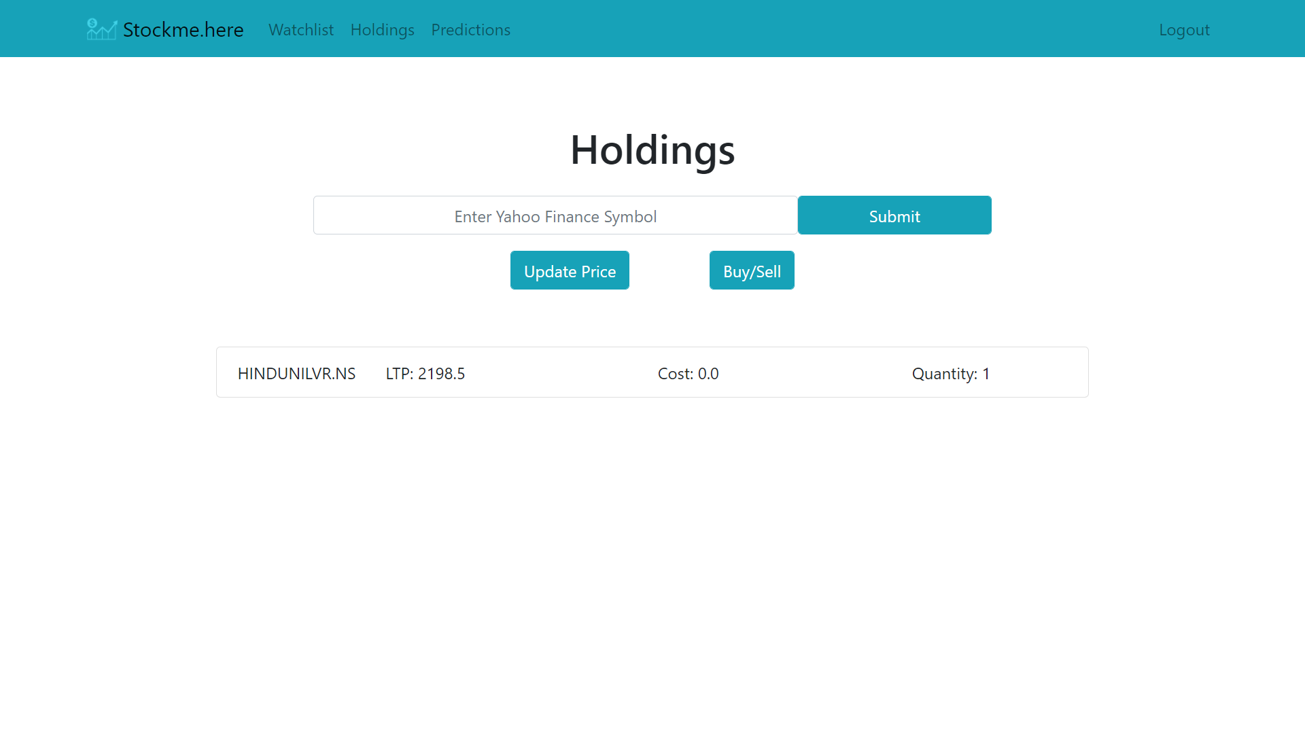
Holdings Page

Slide 36
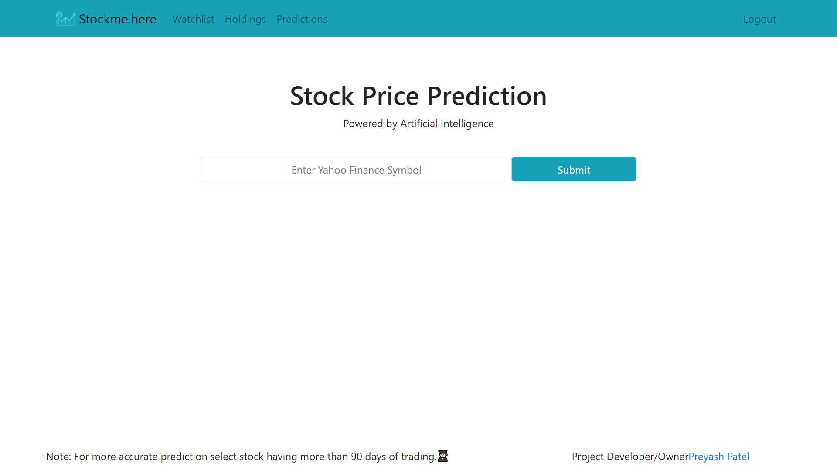
Prediction Page

Slide 37
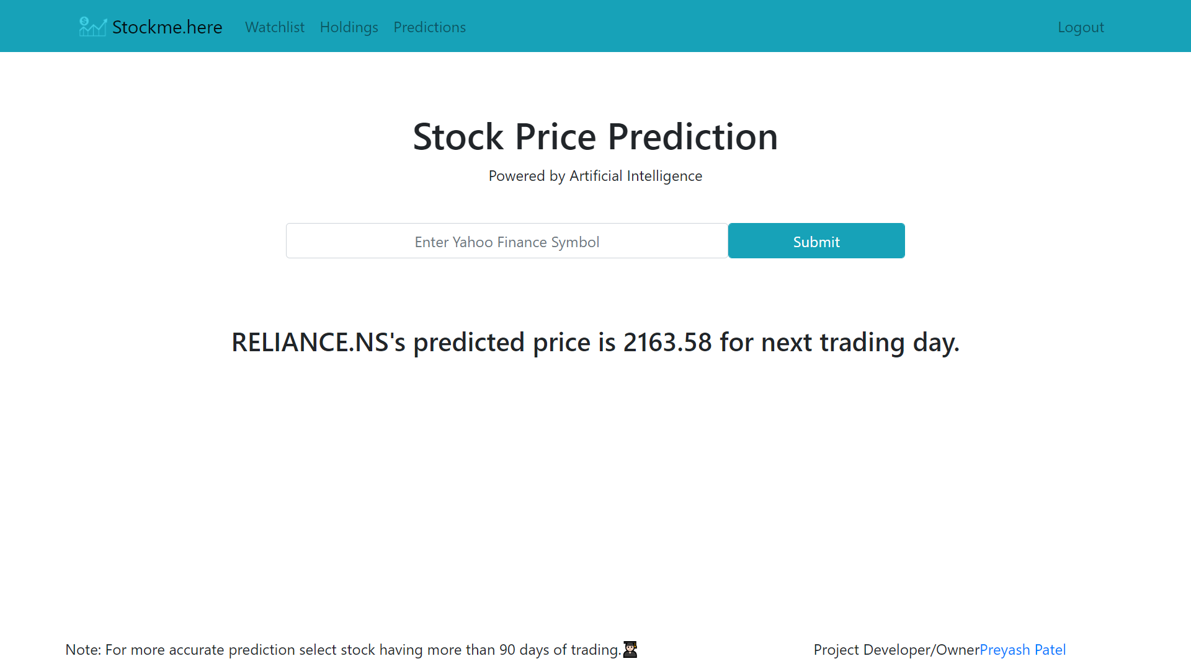
Prediction Page

Slide 38
Testing

Slide 39
Testing For Validation
Sr.No | Validation Checking | Excepted Result | Test Result
1 | Usename | Not Null and Unique | Pass
2 | Password | Not null | Pass
3 | Confirm Password | Not null | Pass

Slide 40
Testing For Watchlist
Sr.No | Validation Checking | Excepted Result | Test Result
1 | Symbol | As per Yahoo Finance | Pass

Slide 41
Testing For Holding
Sr.No | Validation Checking | Excepted Result | Test Result
1 | Symbol | As per Yahoo Finance | Pass
2 | Quantity | Greater then Zero | Pass

Slide 42
Testing For Prediction
Sr.No | Validation Checking | Excepted Result | Test Result
1 | Symbol | As per Yahoo Finance | Pass

Slide 43
Future Enhancement

Slide 44
Future Enhancement
Implement NLTK to have impact of News on Stock Price Prediction
Speeding up the Model training time
Maintain prebuilt model for faster response
News update for respective stock
Stock’s Fundamentals view

Slide 45
Bibliography

Slide 46
Bibliography
https://www.djangoproject.com/
https://in.finance.yahoo.com/
https://www.python.org/
http://tensorflow.org/
http://keras.io/

Slide 47
Thank You

